Slide 1
Destiny Hunter

Slide 2
Character Creation
DIRECTION
CHIMES
BLESSINGS
PERSISTENCY

Slide 3
STAGE 1
TBD

Slide 4
STAGE 1 WOLVES
B=BOW
B

Slide 5
STAGE 2 BOAR
L=LANTERN
L

Slide 6
STAGE 3 GATORS
E=GEM
O=BOOK
O
E

Slide 7
STAGE 4 CROW/OWL
1
OBTAIN “FLIP” SKILL (W)
BOOMER ISLAND
2
3
4
5
6
7
8
9
10
11
12
13
14
15
16
17
18
19
20
21
22
23
24
25

Slide 8
STAGE 5 BEAR
1
G=GLOVES
2
3
4
5
G
6
7
8
9
10
11
12
13
14
15
16
17
18
19
20
21
22
23
24
25

Slide 9
STAGE 6 KOBOLD
1
T=TRAPS
If have gloves, boxes can be pushed
Can shoot boxes to RNG reveal TRAPS
2
3
4
5
6
7
8
9
10
11
12
13
14
15
16
17
18
19
20
21
22
23
24
25

Slide 10
STAGE 7 LIONS
1
STATUES, can obtain (A) arrows or (P) persistence (ONCE ONLY)
RNG positioned trees
Can deploy traps that lions won’t see (TRAP slows lion and does a lot of damage)
Avoid stepping in your own traps
2
3
4
(
\
5
\
)
6
7
8
9
10
11
12
13
14
15
16
17
18
19
20
21
22
23
24
25

Slide 11
STAGE 8 DRAGON
1
Dragon will have 4 heads: HEART, DIAMOND, SPADE, CLUBS
This map will have 2x or3x range bonus
Dragon can shoot fire balls that make grass catch fire, defeat heads before all grass is on fire! (stepping in fire will cause damage)
Dragon can attack clear across the map
2
3
4
5
6
7
8
9
10
11
12
13
14
15
16
17
18
19
20
21
22
23
24
25

Slide 12
1
2
3
4
5
6
7
8
9
10
11
12
13
14
15
16
17
18
19
20
21
22
23
24
25
26
27
28
29
30
31
32
1
2
3
4
5
5
6
7
8
9
10
11
12
13
14
15
16
17
18
19
20
21
22
23
24
25
26
27
28
29
30
31
32
1
2
3
4
5
6
7
8
9
10
11
12
13
14
15
16
17
18
19
20
21
22
23
24
25
26
27
28
29
30
31
32
1
2
3
4
5
6
7
8
9
10
11
12
13
14
15
16
17
18
19
20
21
22
23
24
25
26
27
28
29
30
31
32

Slide 16
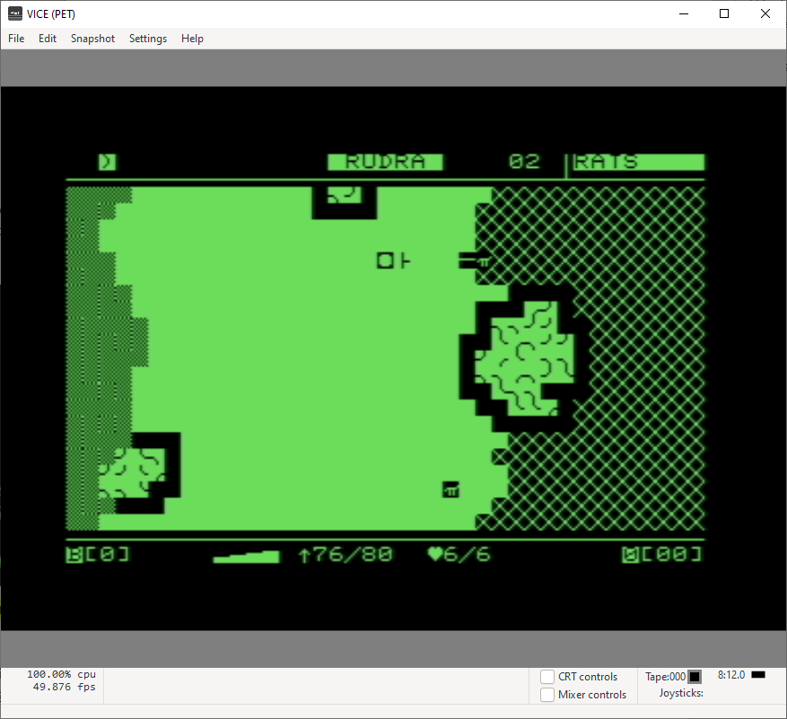
stage name
remaining HP of last hit CHALLENGE
inventory and skills
persona name
BEACH
arrow
WATER
your character
with bow
GRASS
ROCKS
blessings count
CHALLENGE: a rat
health
stamina bar
arrow count /
arrow capacity
persistency count

Slide 17
HIT vs STEALTH BOX
Attack Box (+1 on all sides of the CHALLENGE icon)
π
STEALTH becomes a “Sense Box”
((9-STEALTH)*2)-1
e.g. STEALTH of 7 becomes SENSE_RANGE of
((9-7)*2)-1 = 3
on each side of the CHALLENGE (this is for a 1x1 icon, but concept would
extend to any sized icon)

Slide 18
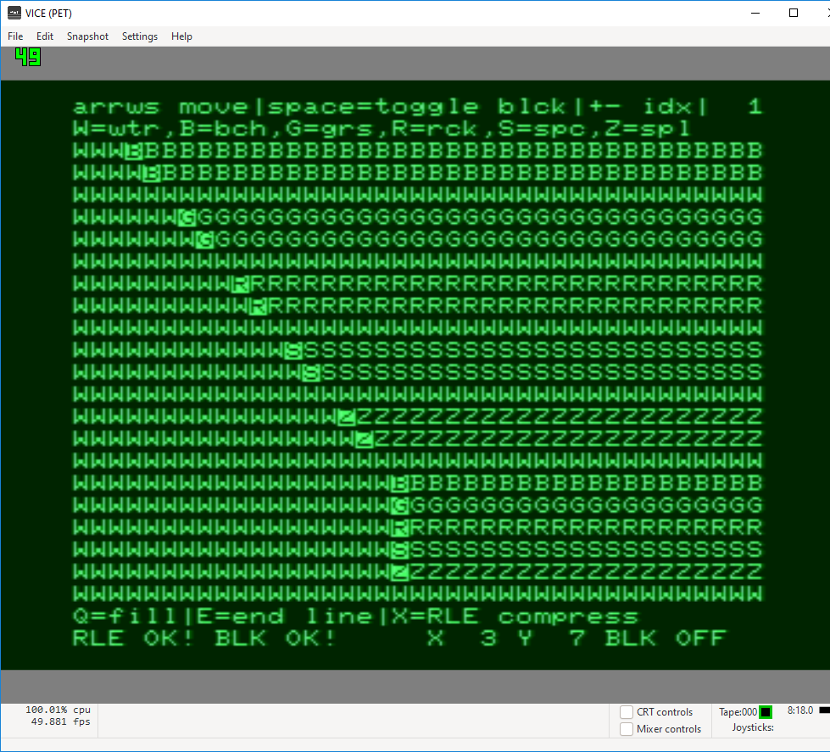

Slide 19
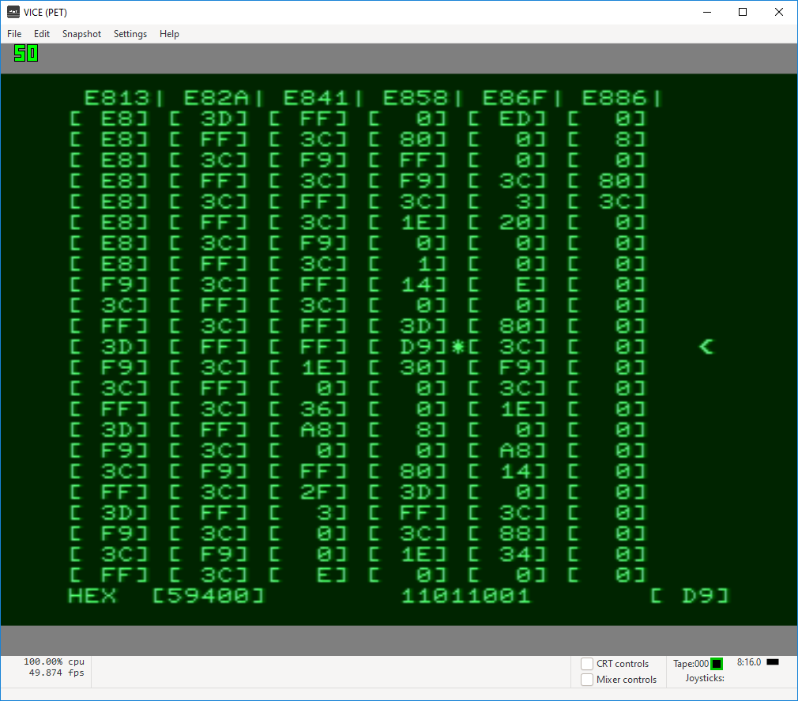

Slide 20
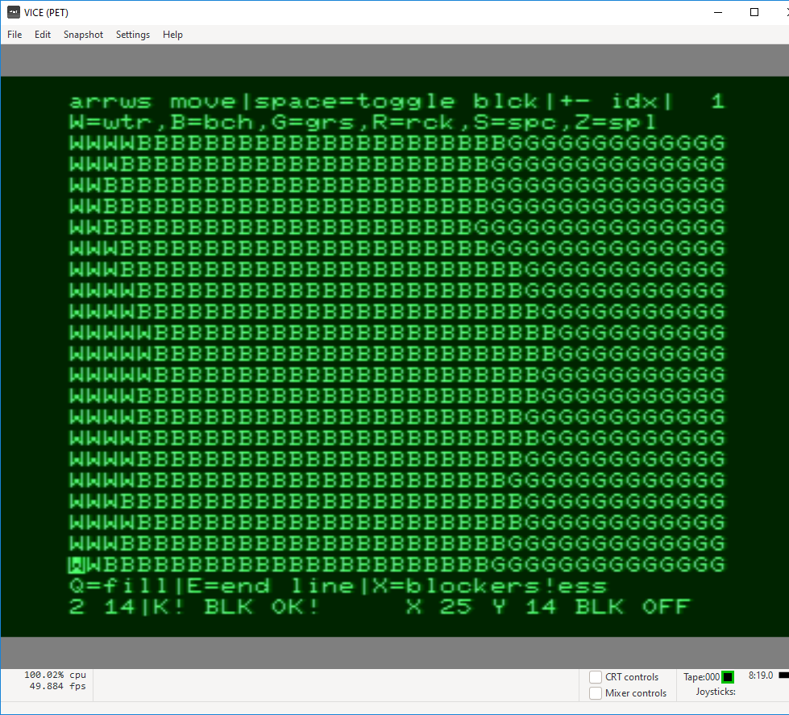
1

Slide 21
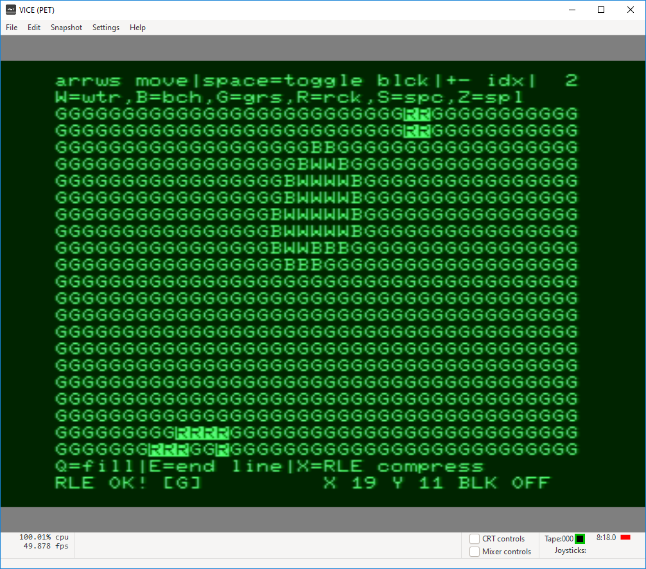
2

Slide 22
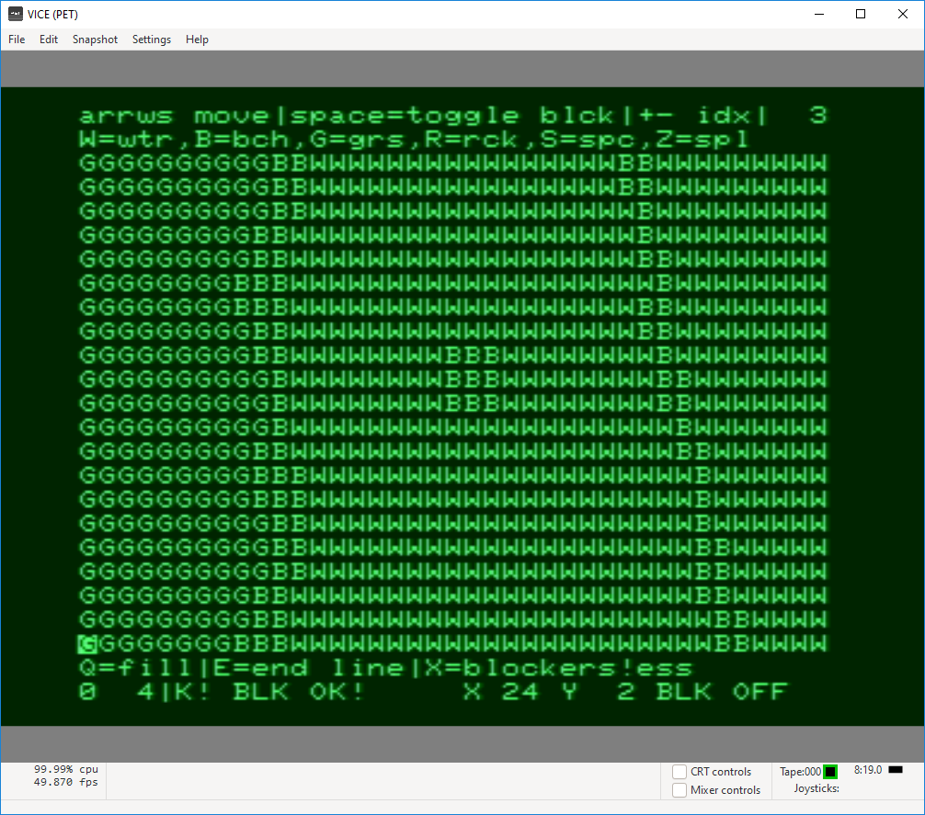
3

Slide 23
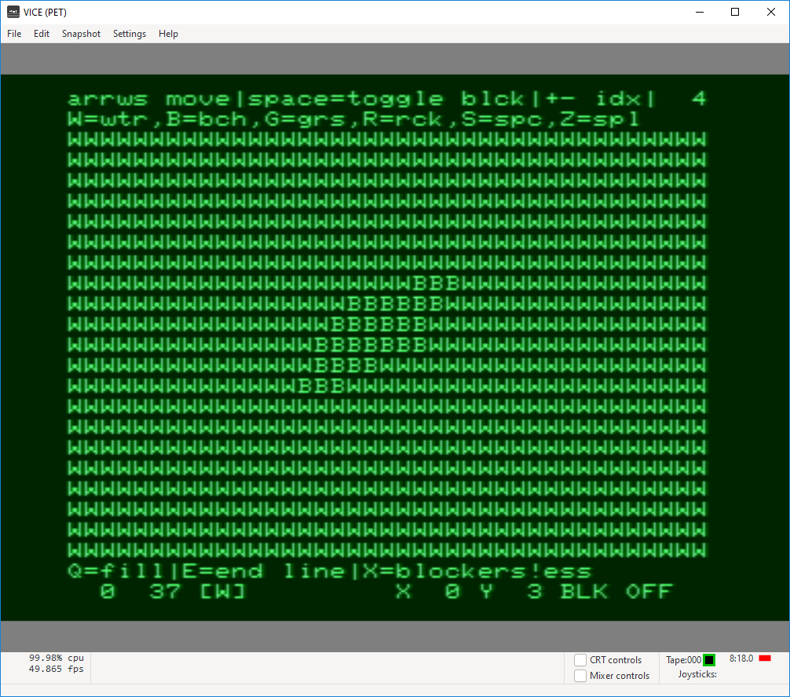
4

Slide 24
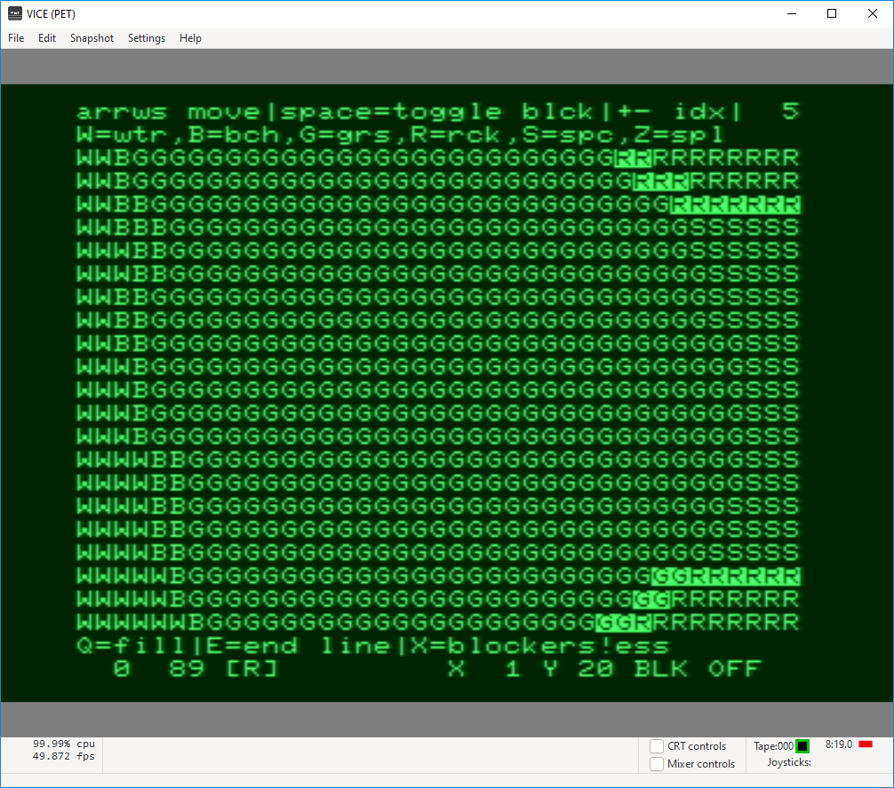
5

Slide 25
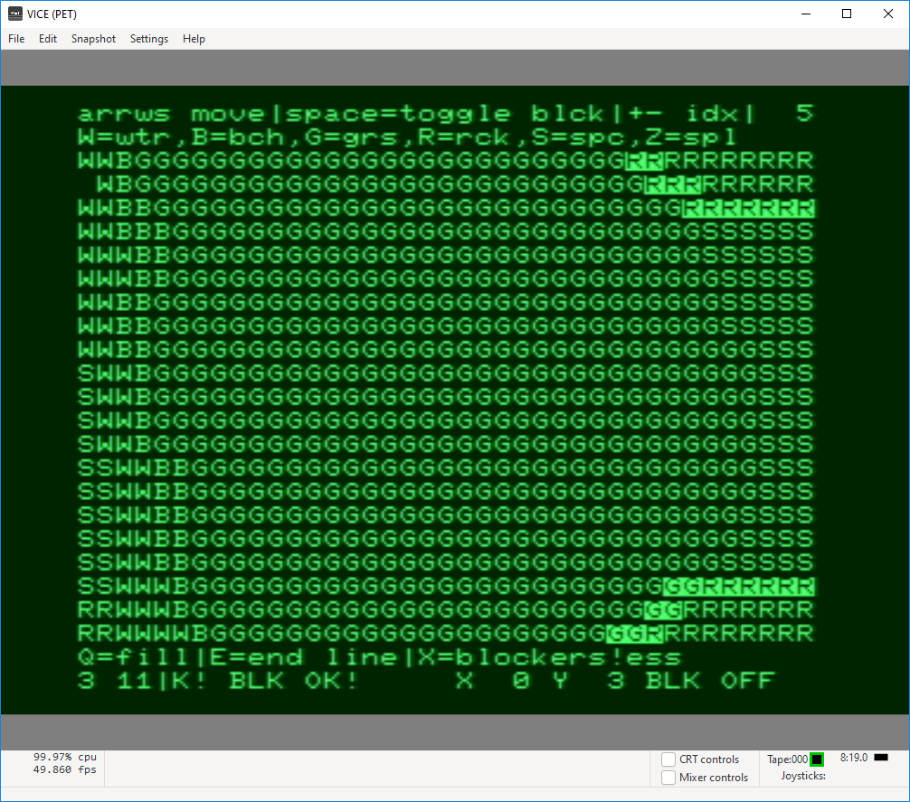
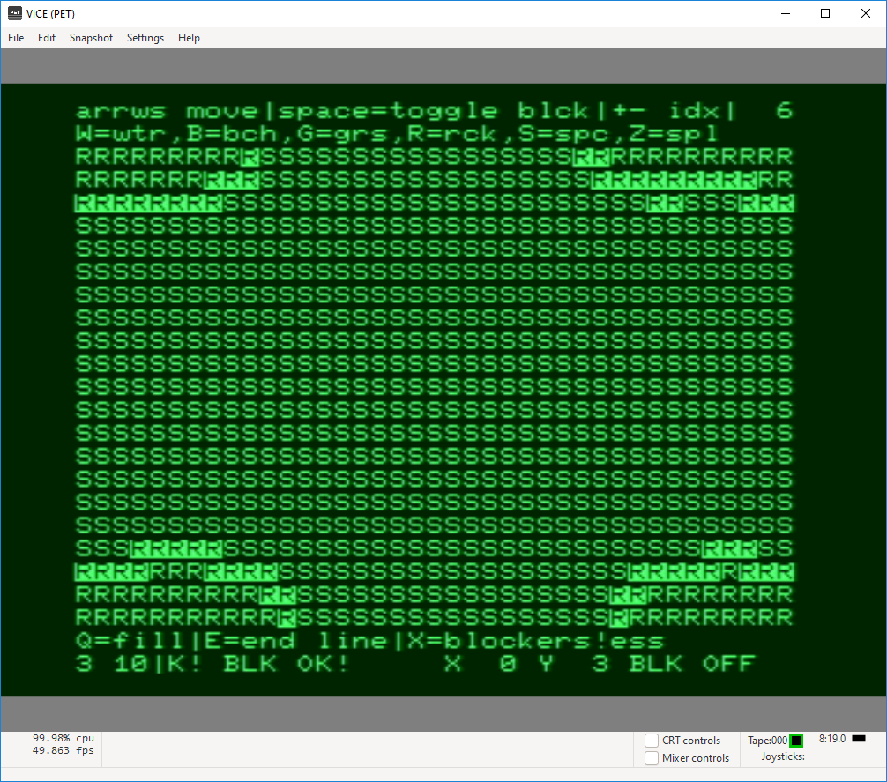
6

Slide 26
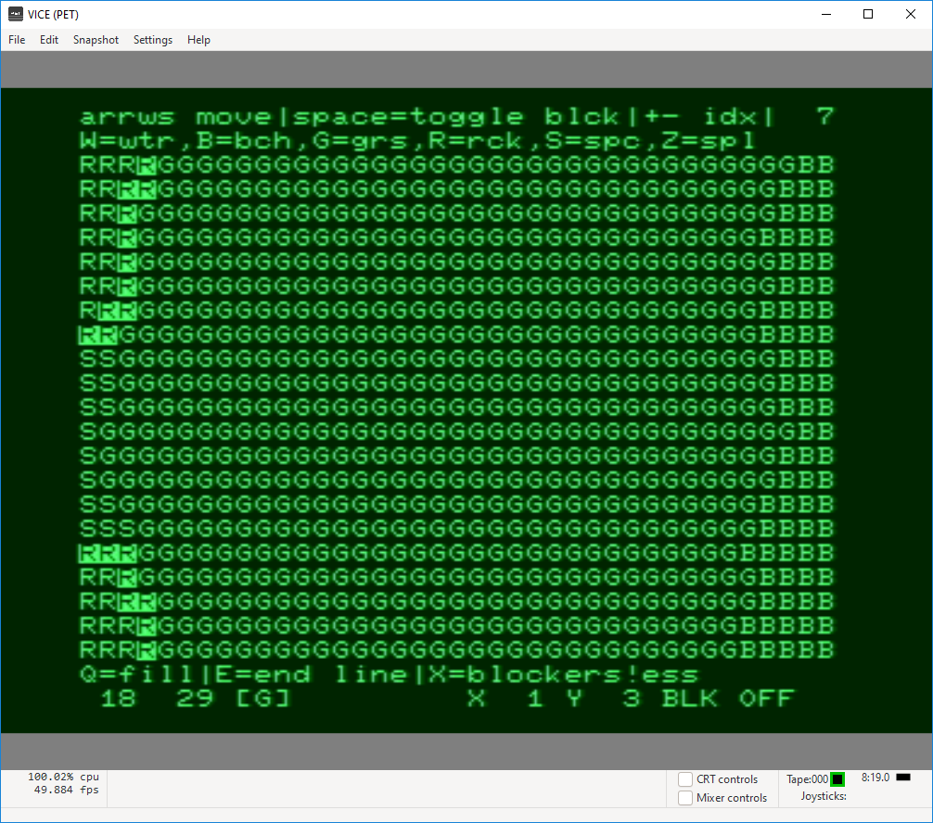
7

Slide 27
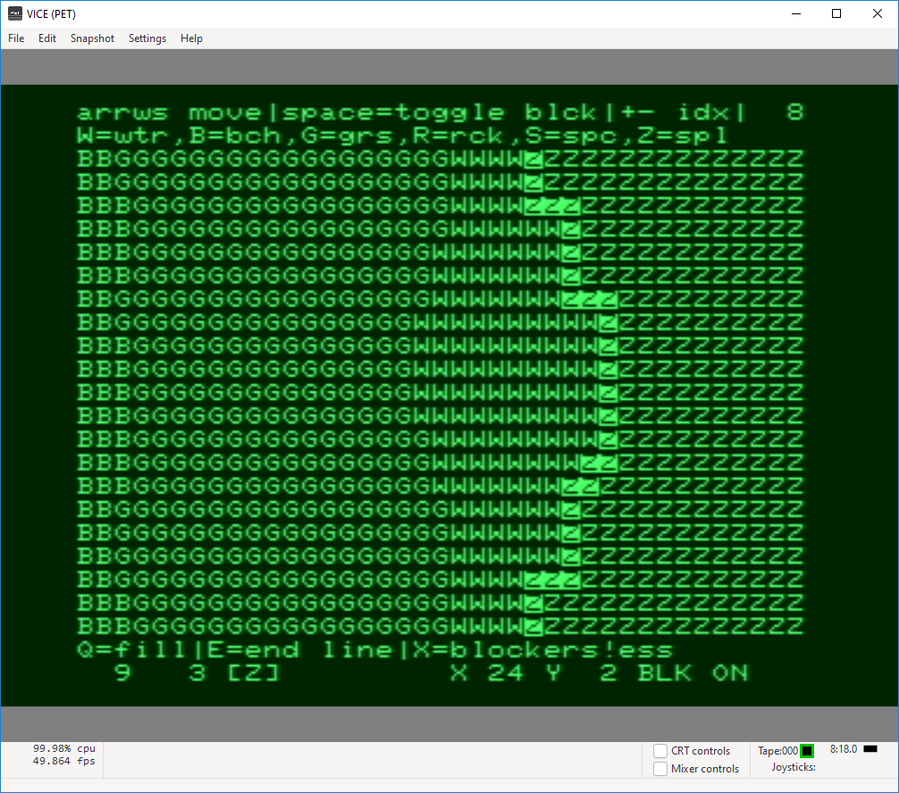
8

Slide 29
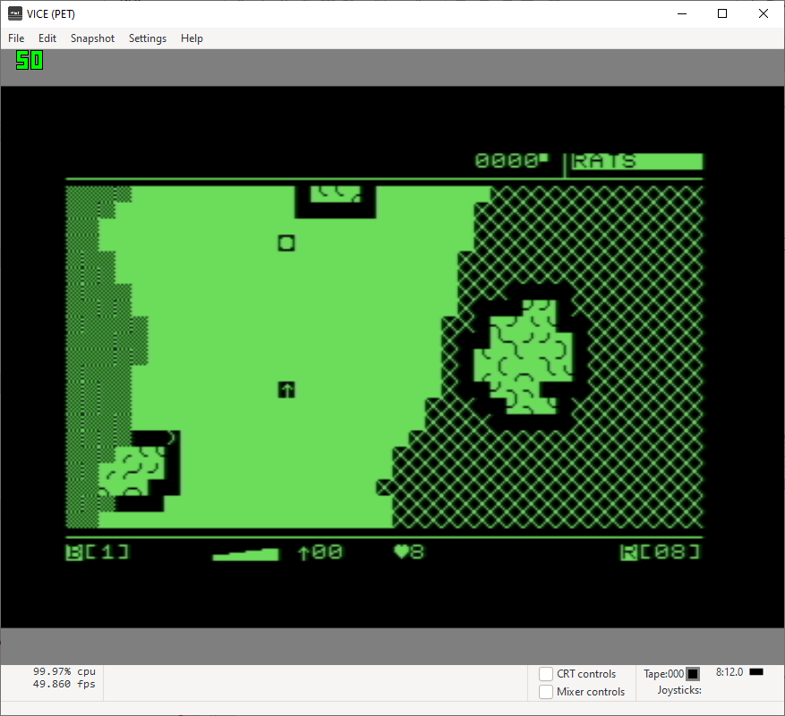

Slide 30
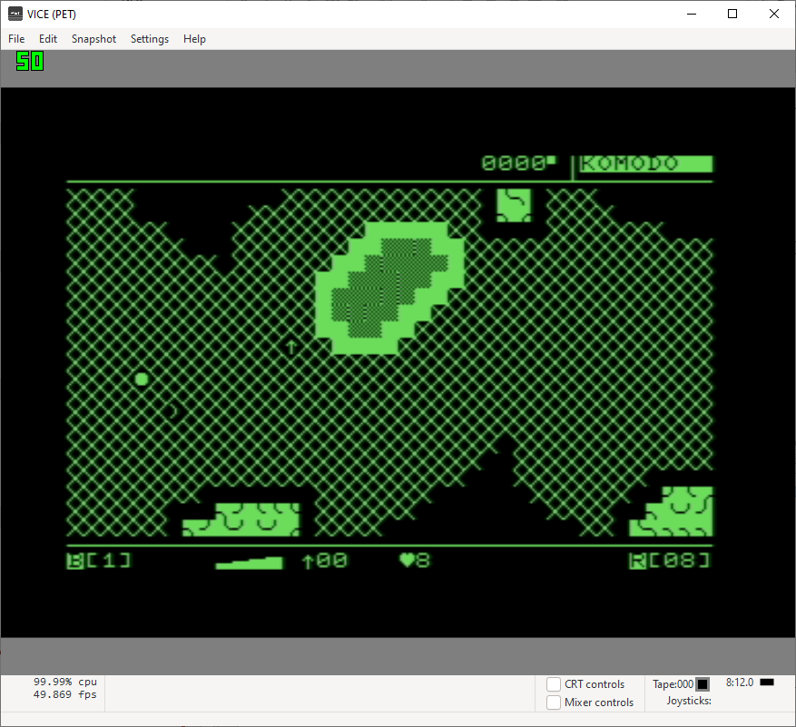

Slide 31
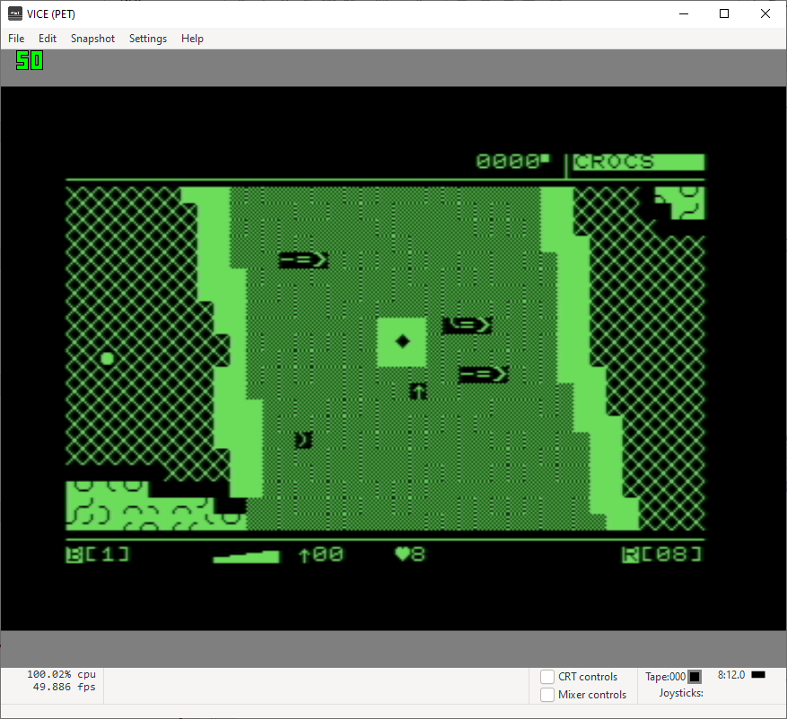

Slide 32
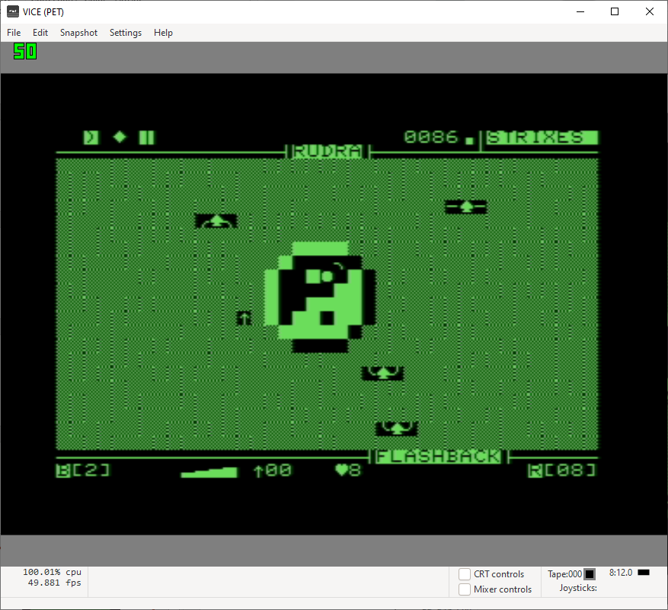

Slide 33
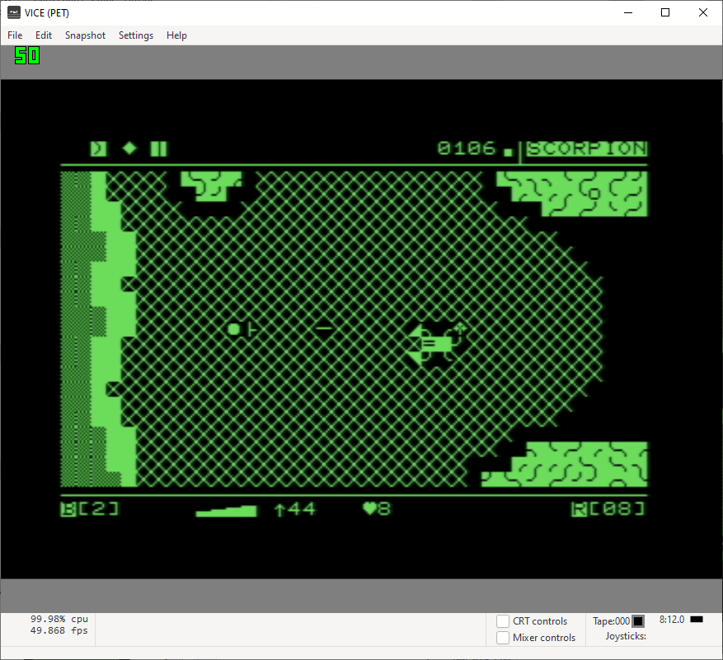

Slide 34
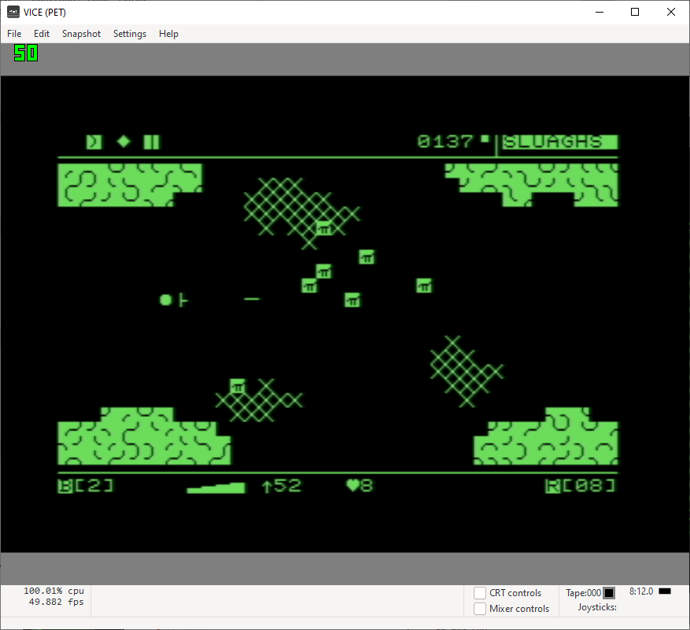

Slide 35
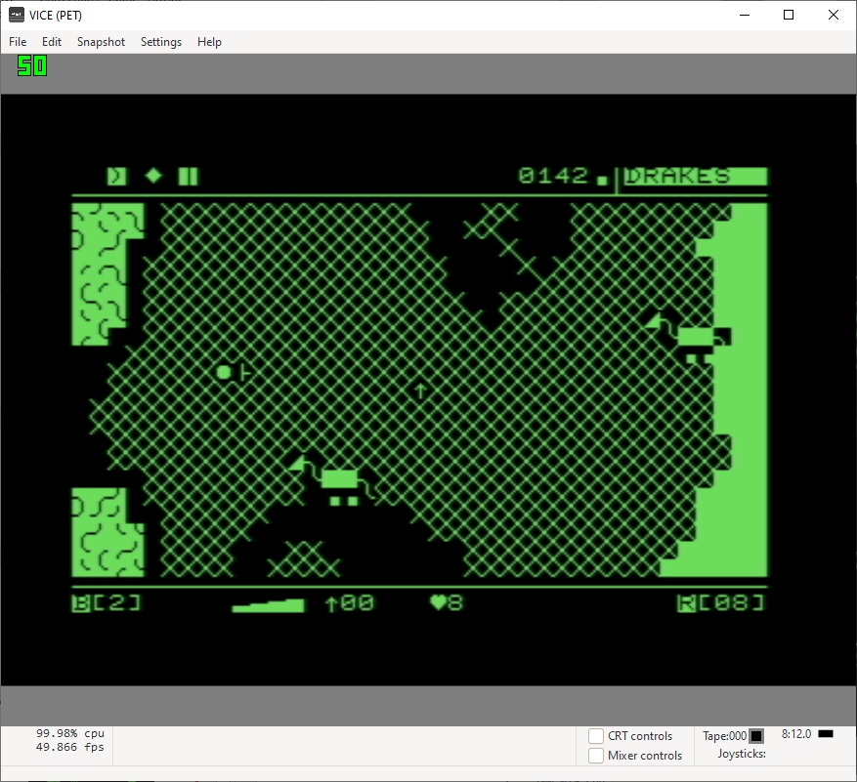

Slide 36
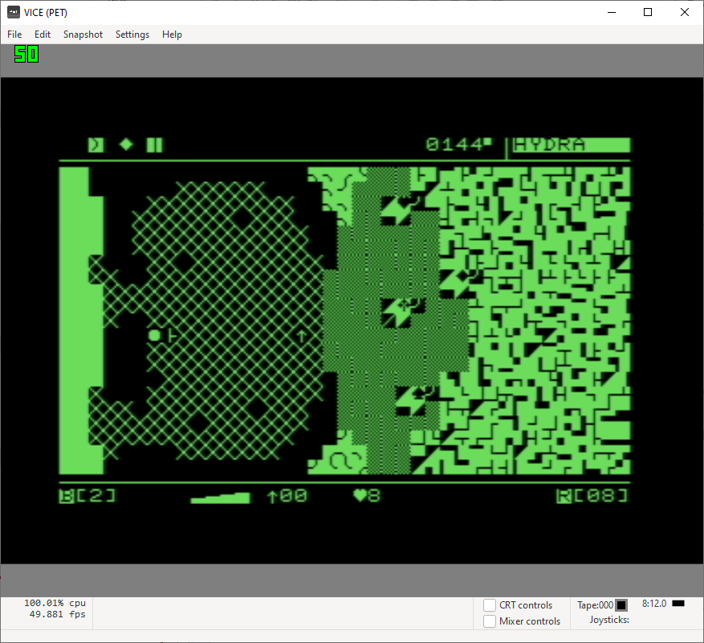

Slide 37
R2

Slide 38
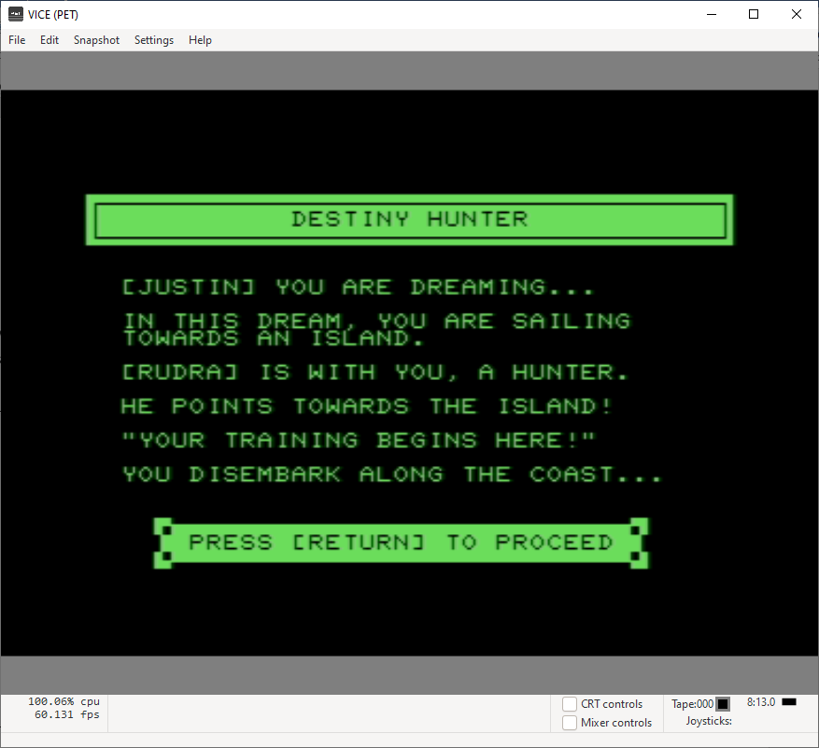

Slide 40
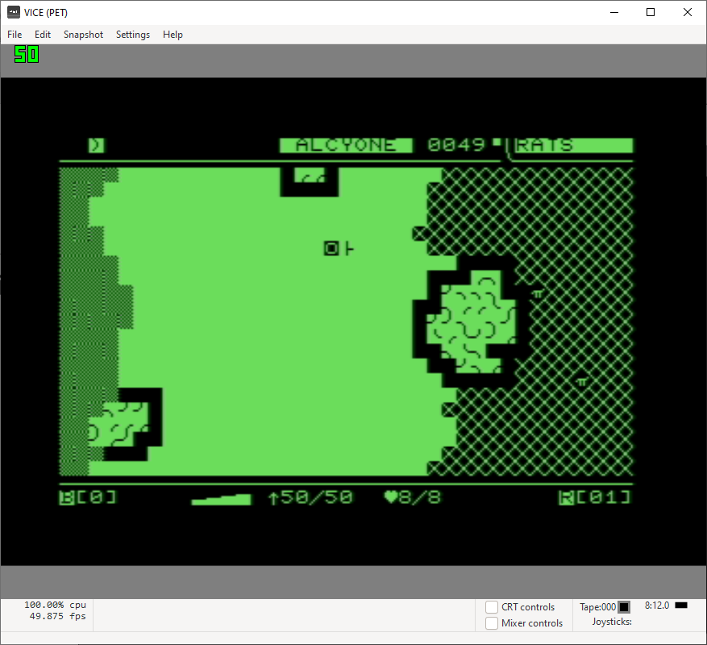
R2

Slide 41
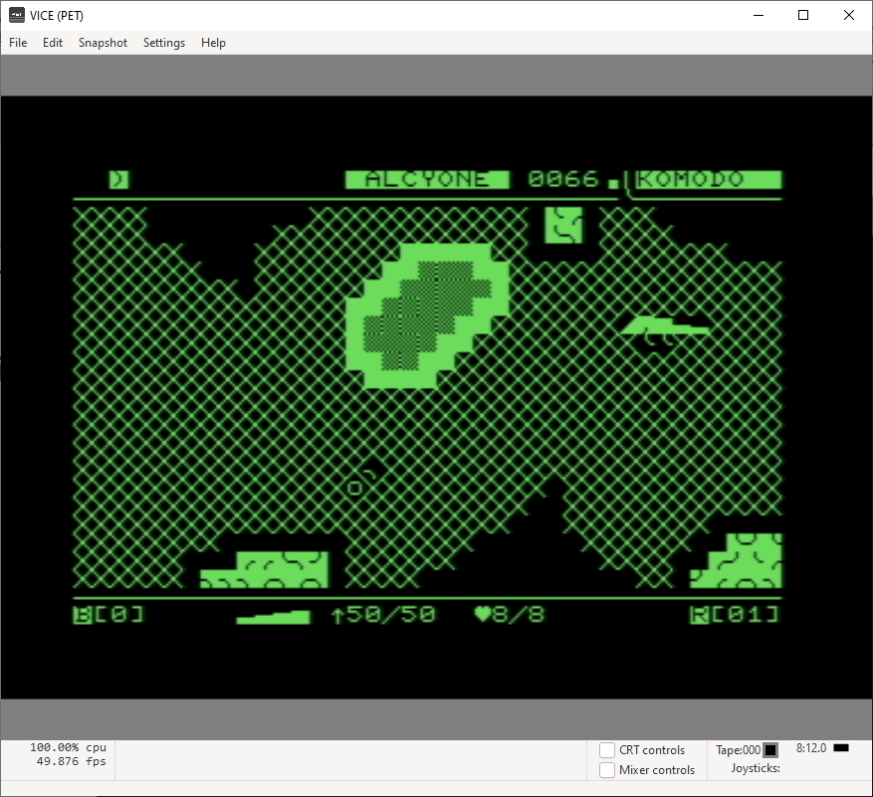

Slide 42
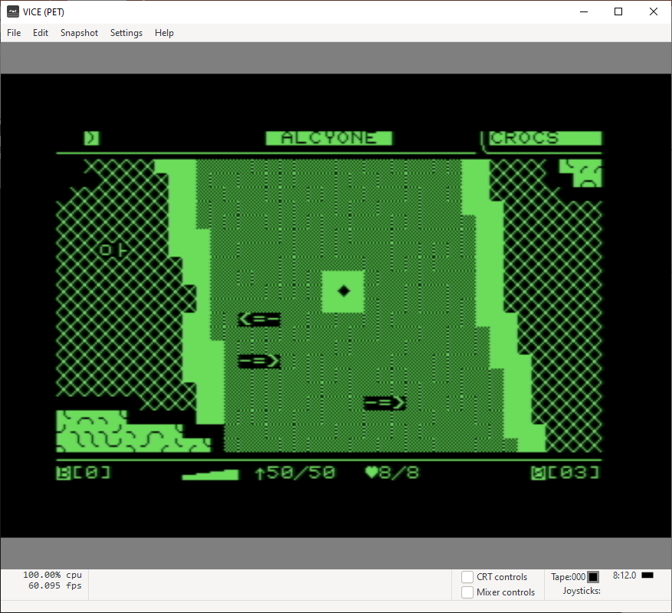

Slide 43
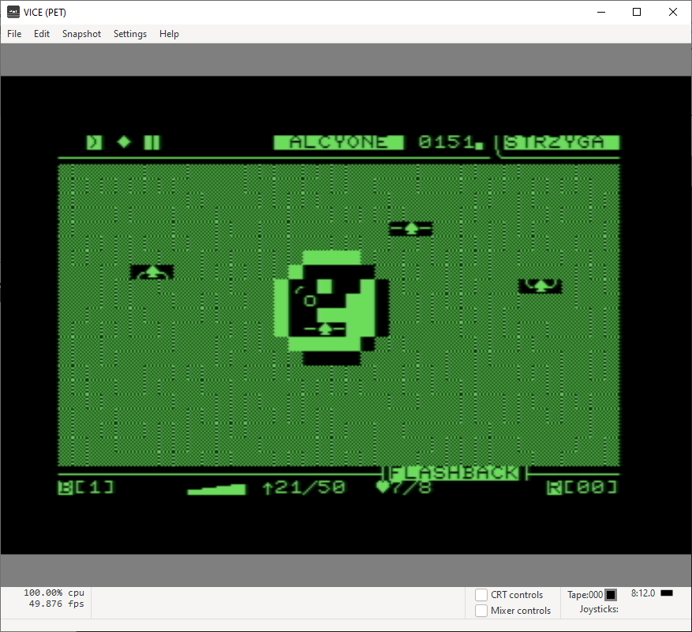

Slide 44
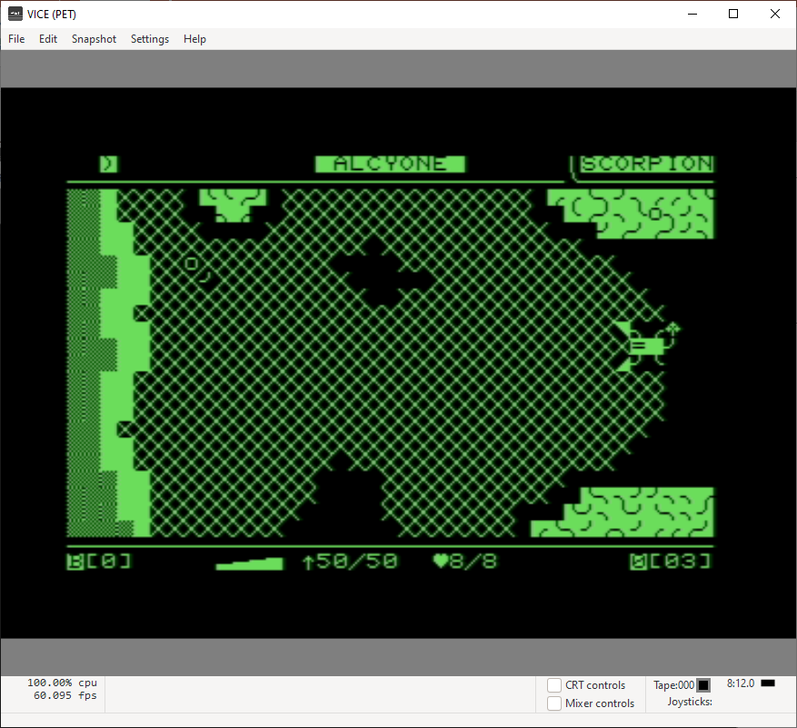

Slide 45
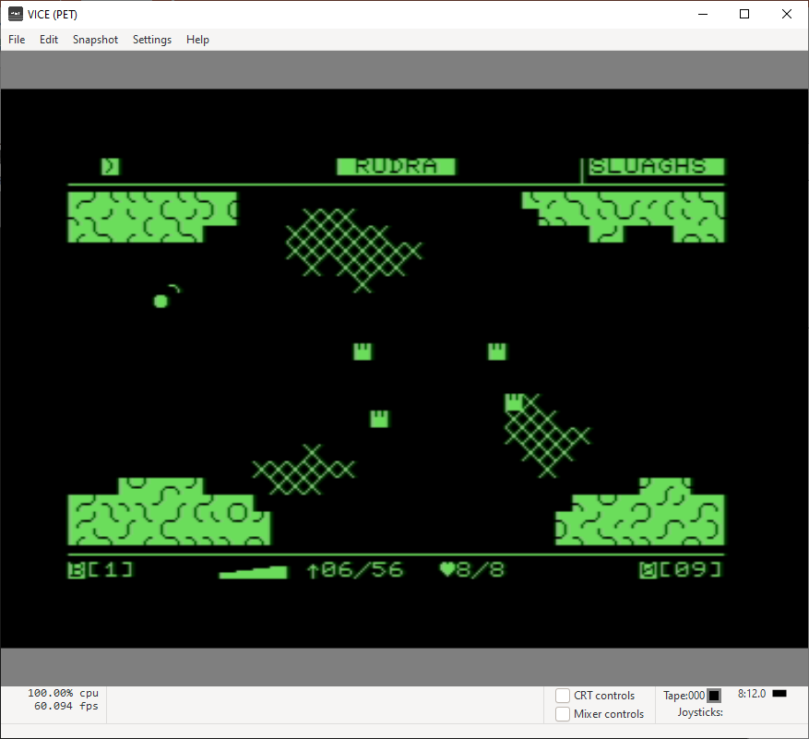

Slide 46
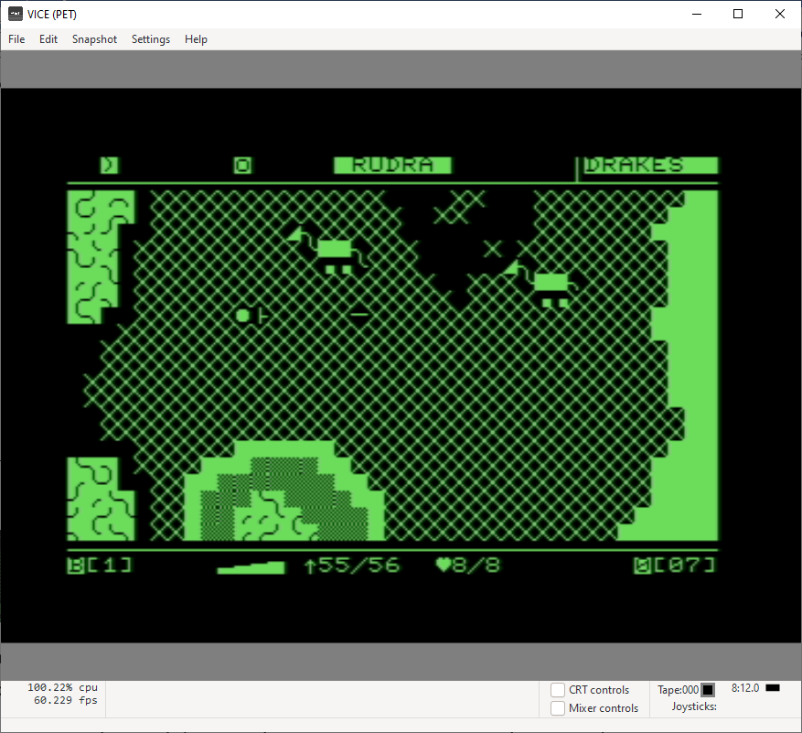

Slide 47
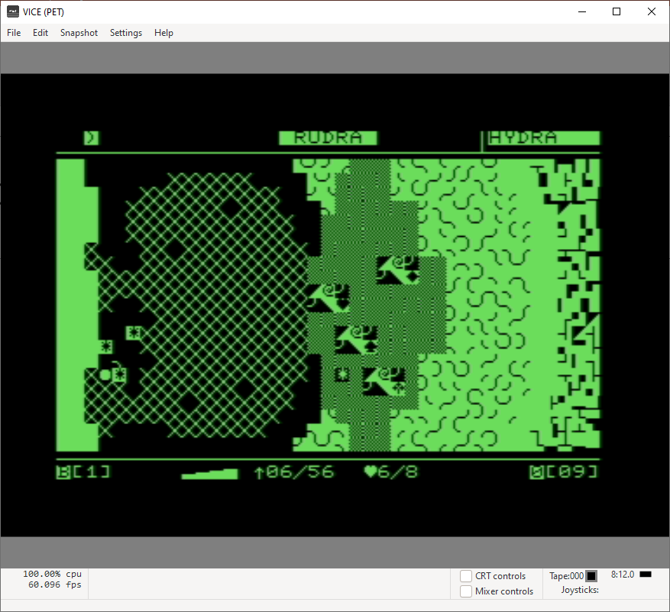

Slide 48
